Slide 1


The Lean Startup
Eric Rees

Slide 2
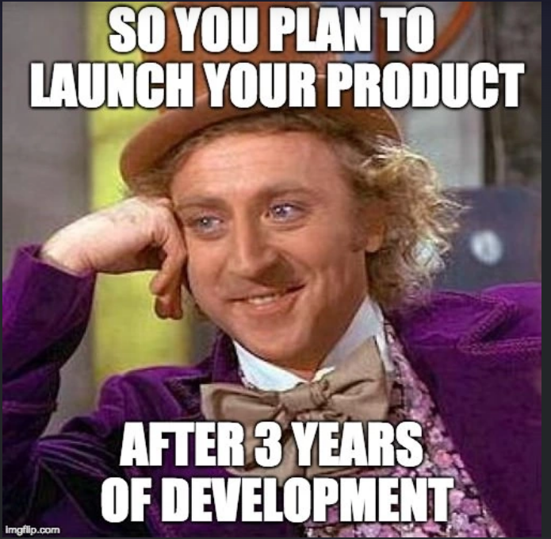
Why lean
A guideline to build effective organisation
Minimise Waste (Minimise Effort)
Sustainable product development
Sustainable competitive advantage
Finding an entrepreneur inside us
Start ups are inherently risky, in corporates projects/ideas are.

Slide 3
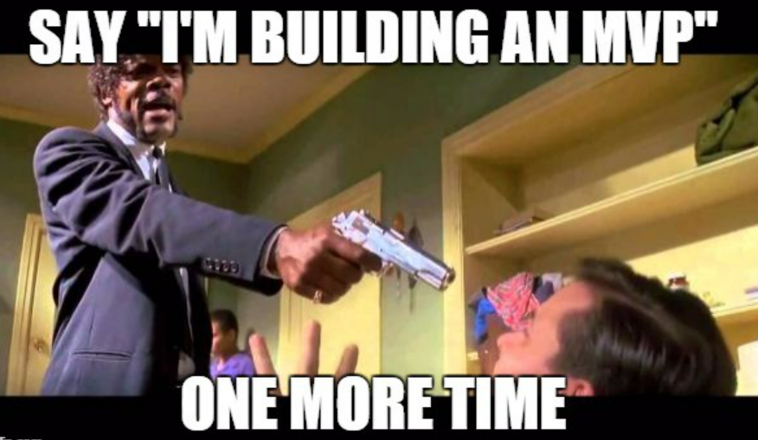
How to do Lean
Build and produce in batches
Measure the effect of each batch using metrics
Validate learnings along the way
Learn from failure, but don’t use failure as an excuse
Fail fast
Observe customers, don’t ask
Improve batch and repeat
https://medium.com/@LoganTjm/how-uber-airbnb-dropbox-released-mvps-to-achieve-rapid-growth-d823ac6eaed5

Slide 4
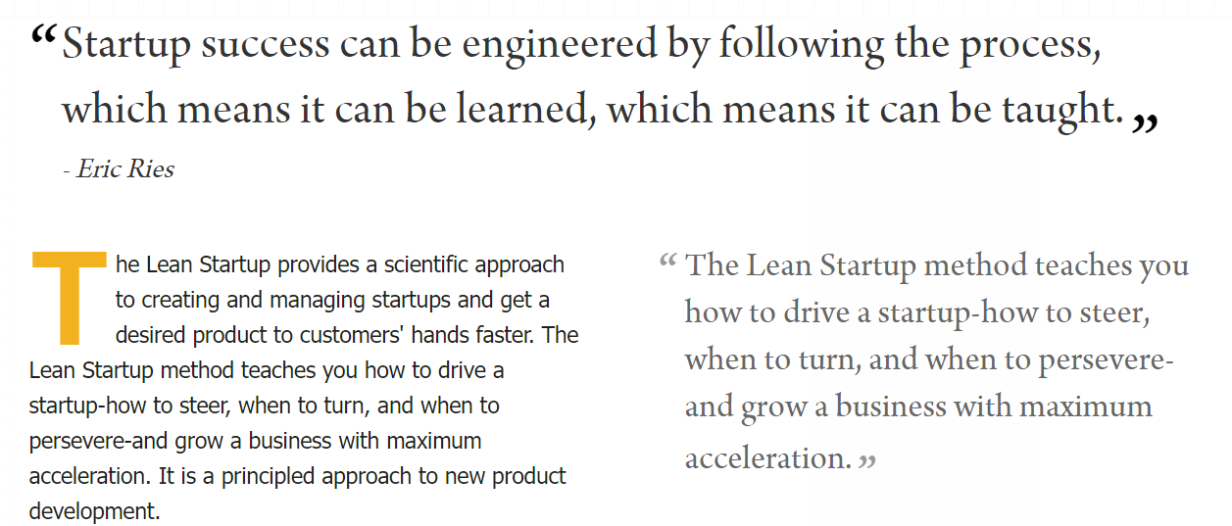
What is Lean Startup

Slide 5
Define the right metrics
Organisation 1 | Organisation 2
1000 Clicks | 200 Clicks
100 Customers walk in to showroom | 10 Customers walk in the showroom
Can we say organisation 1 product is successful than other?
This is the problem with vanity metrics

Slide 6

Engines of Growth and their metrics
Sticky -> Retention
New customers% > Churn %
Viral -> Per customer referred and adopt the product
Has to be above 1.0
Paid -> Cost of acquiring each customer subtracted from lifetime revenue
Push revenue per customer higher or reduce cost of acquiring new customer
If metrics ae not improving over few iterations, one must think of a pivot.

Slide 7
Type of Pivots
Zoom in Pivot
Zoom out Pivot
Customer Segment Pivot
Customer Need Pivot
Platform Pivot
Business Architectural Pivot
Value Capture Pivot
Engine of Growth Pivot
Channel Pivot
Technology Pivot

Slide 8
What engine of growth is your project/organisation?
Word of mouth (Organisational referring or department referring)
Uplift in new customers or reduce churn in old customers
PROMs
Hypothesis – People would like to sign up to program, and can save Insurance some money, if right leads are selected. If people benefit from the program, they will stay with the insurance company?

Slide 9
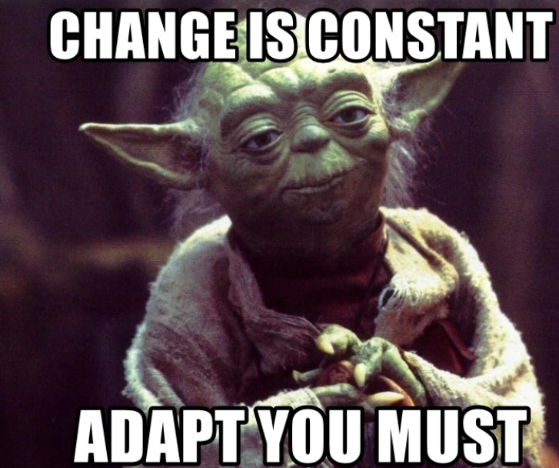
Lets Adapt
Invest in training
Proportional to the problem at hand
The 5 whys framework
Learn to champion this method, but adapt to the own style
Take a problem at a time
Importance of a cross functional team
Early adopters are forgiving, not the mainstream customers

Slide 10
Time to innovate
Scarce but secure resources
In startups budgets are scarce but shouldn’t alter in between build measure learn lifecyle
Independent Development Authority
Autonomy in the process
Direct access to customers and internal stake holders
Cross functional teams
A personal stake in the outcome
Recognition goes the long way
Financial rewards and promotions are good, but not absolute necessary
If outcomes leads to financial reward, it must be clear and transparent

Slide 11
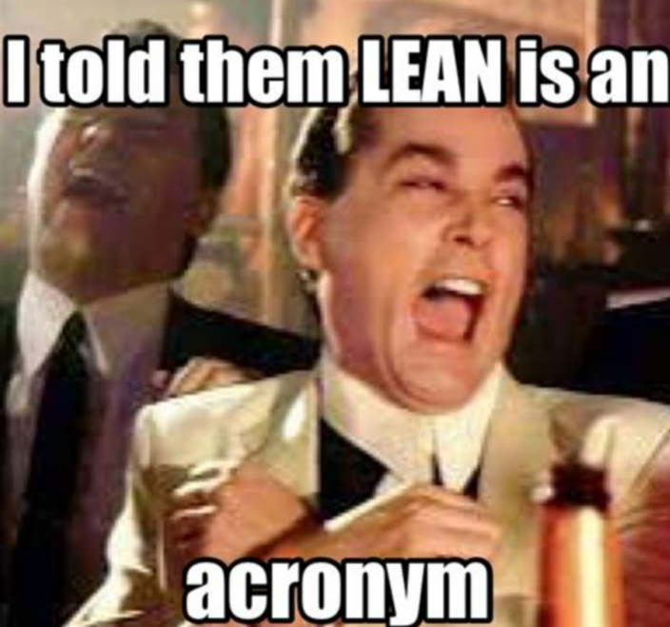
Is lean for everyone?
If we don’t measure our goals against our outcomes, how do we know we are on the right track
If this is for individuals , shouldn’t this be for organisation
Shouldn’t this be for teams and processes
Shouldn’t this be for the way we work
Lean is a framework, not a blueprint

Slide 12
Limitations of lean startup
The book is majorly focussed on start ups
Less B2B examples in the book

Slide 13
Thank you

